Slide 1

My Life, My Experience
Eric Zhao
December 11, 2017

Slide 2

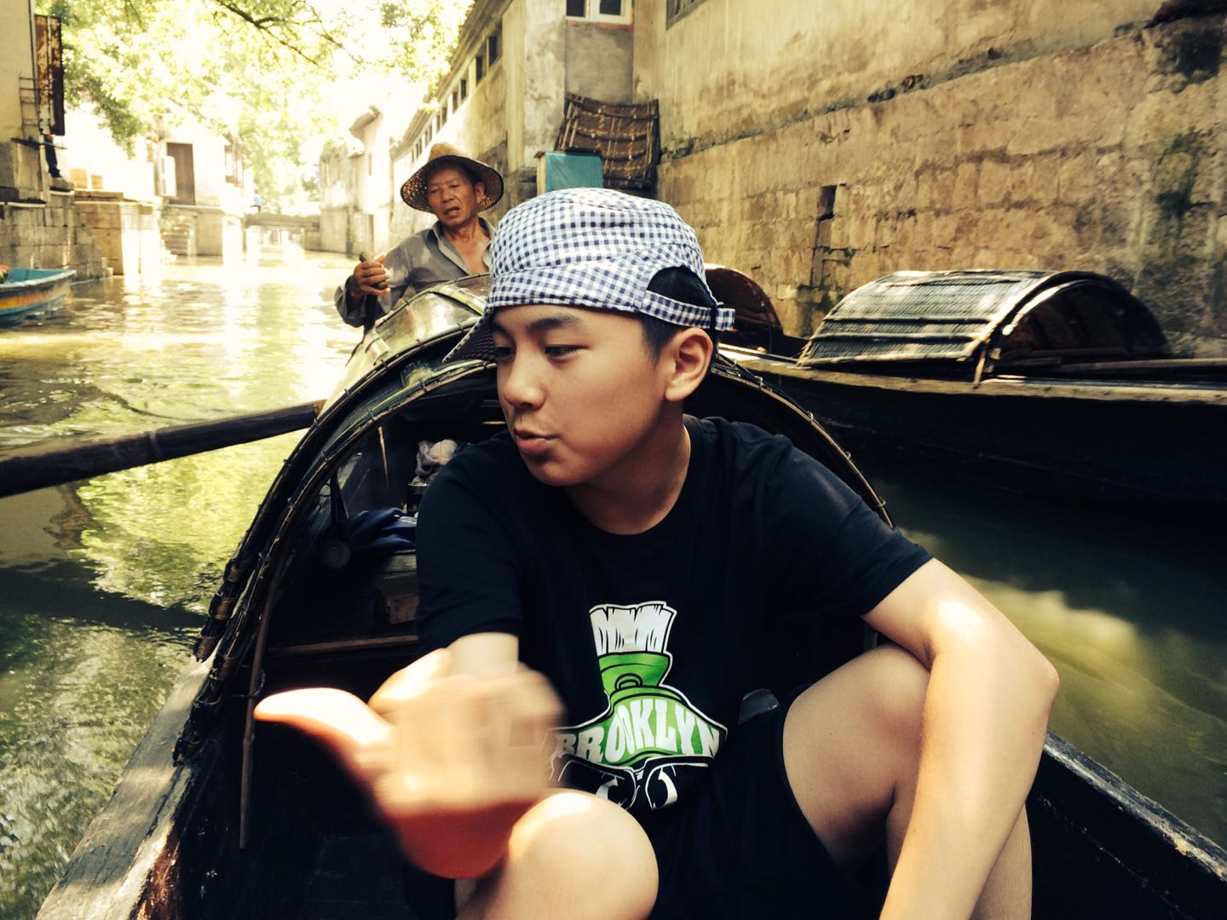
Chinese Name: 赵哲艺 English Name: Eric D.O.B.: December 21, 2002 Hometown: Shanghai, China Gender: Male Height: 175cm Introducing Myself Present: Grade 9 Current School: Shanghai Huayu Private Middle School Personality: Friendly, Helpful and Hardworking Interests: Sports, Guitar, Listening to music Favorite Movie: Star Wars Favorite Book: The Old Man and the Sea

Slide 3

Five aspects of my life
1. School life
2 . Volunteer experience
3. Summer school
4. My travels
5. My families

Slide 4

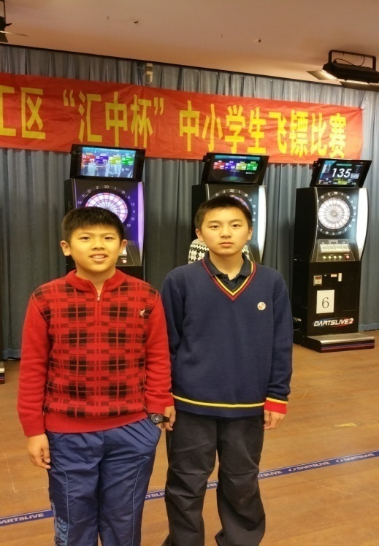
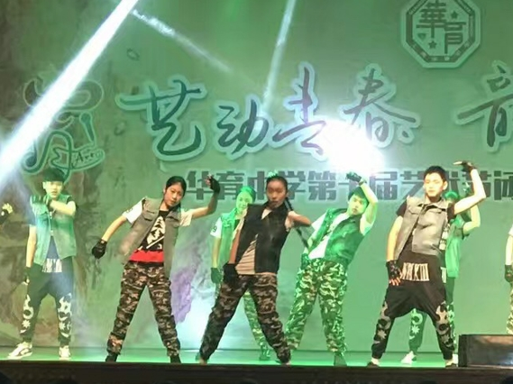
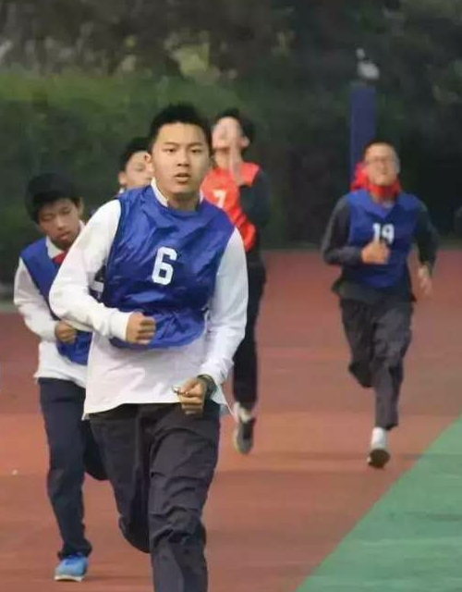
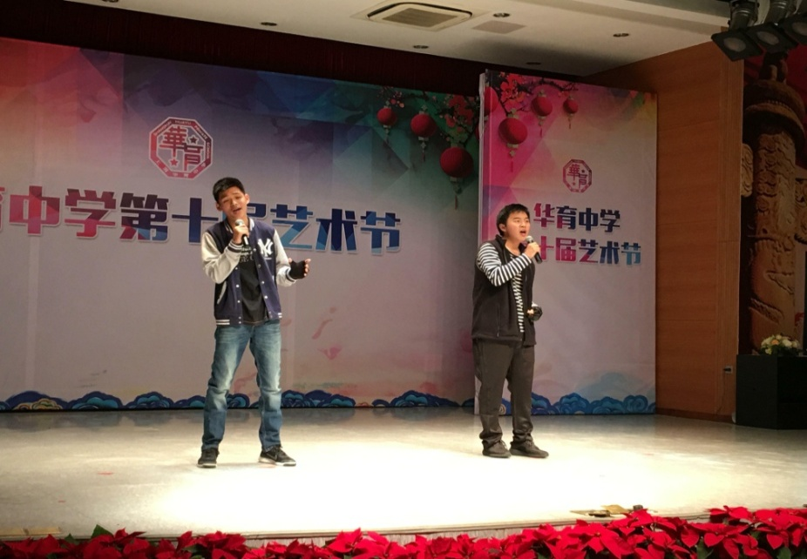
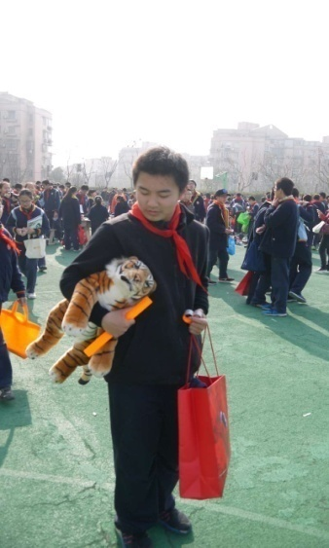
Wonderful school life helps me learn and accumulate new experiences
School activities and my friends

Slide 5

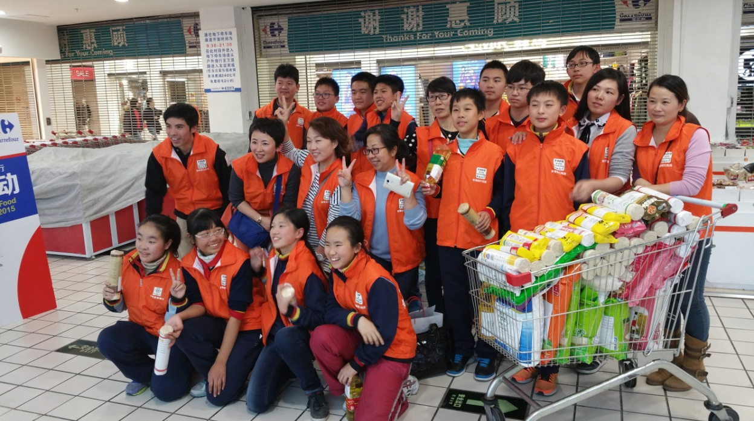
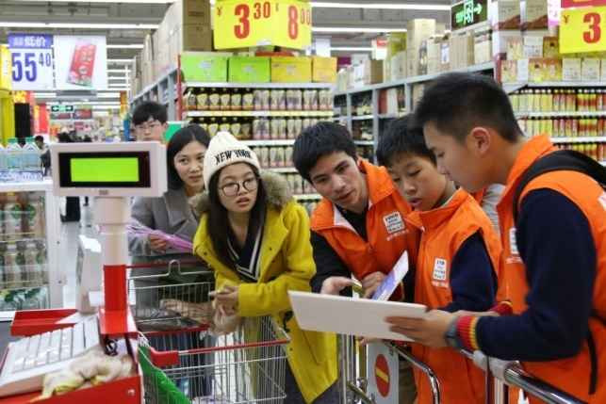
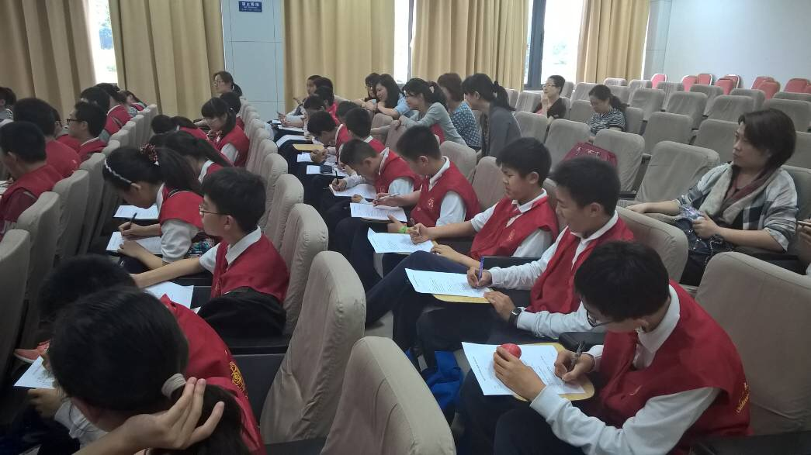
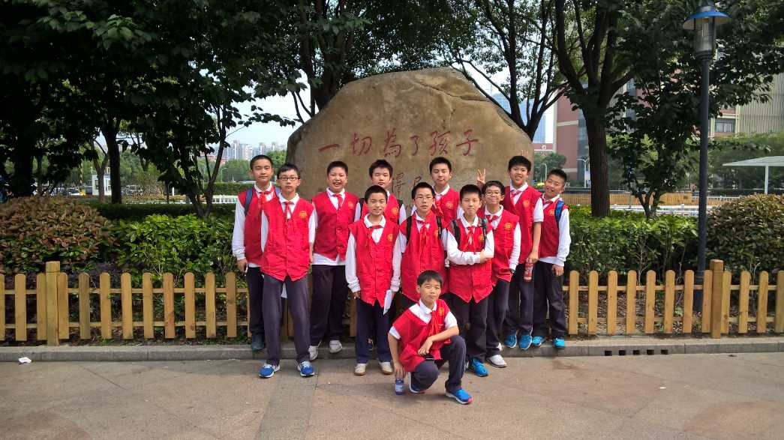
Volunteering to help other people makes me happy and also increases my social experience
Training and volunteering at the local hospital
Collecting food donations for poor children

Slide 6

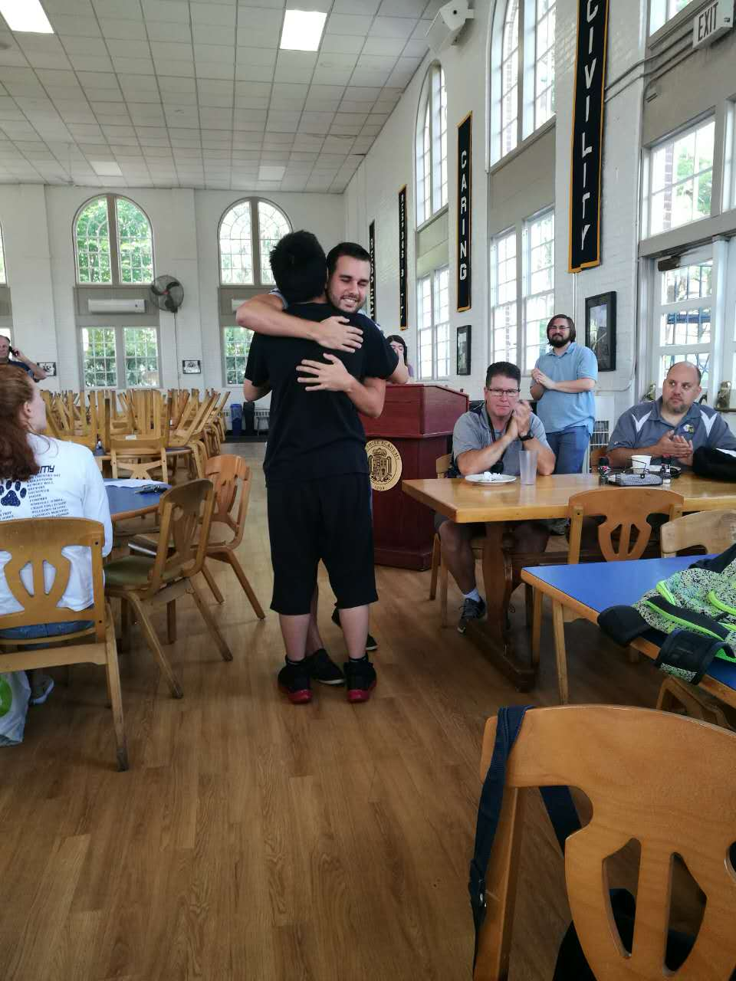
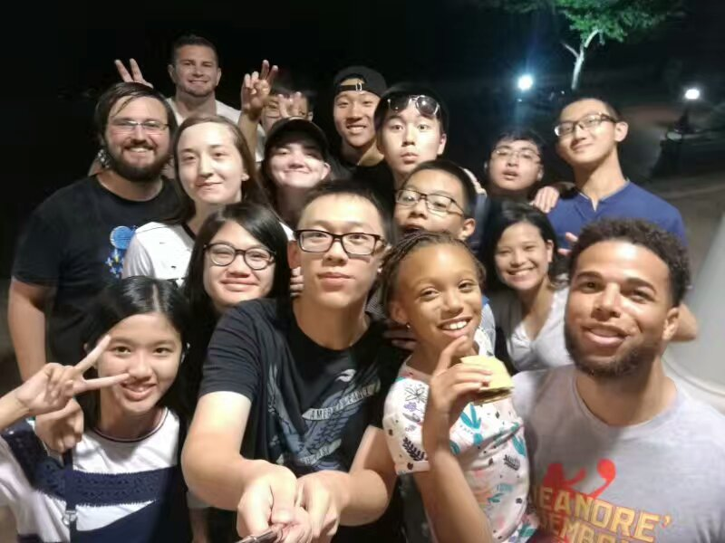
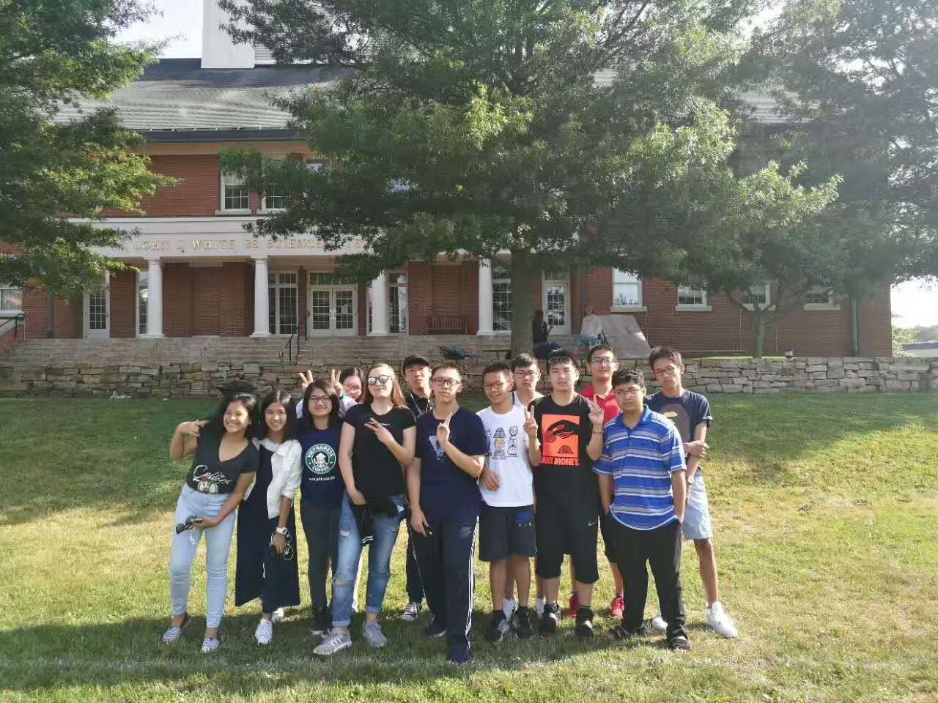
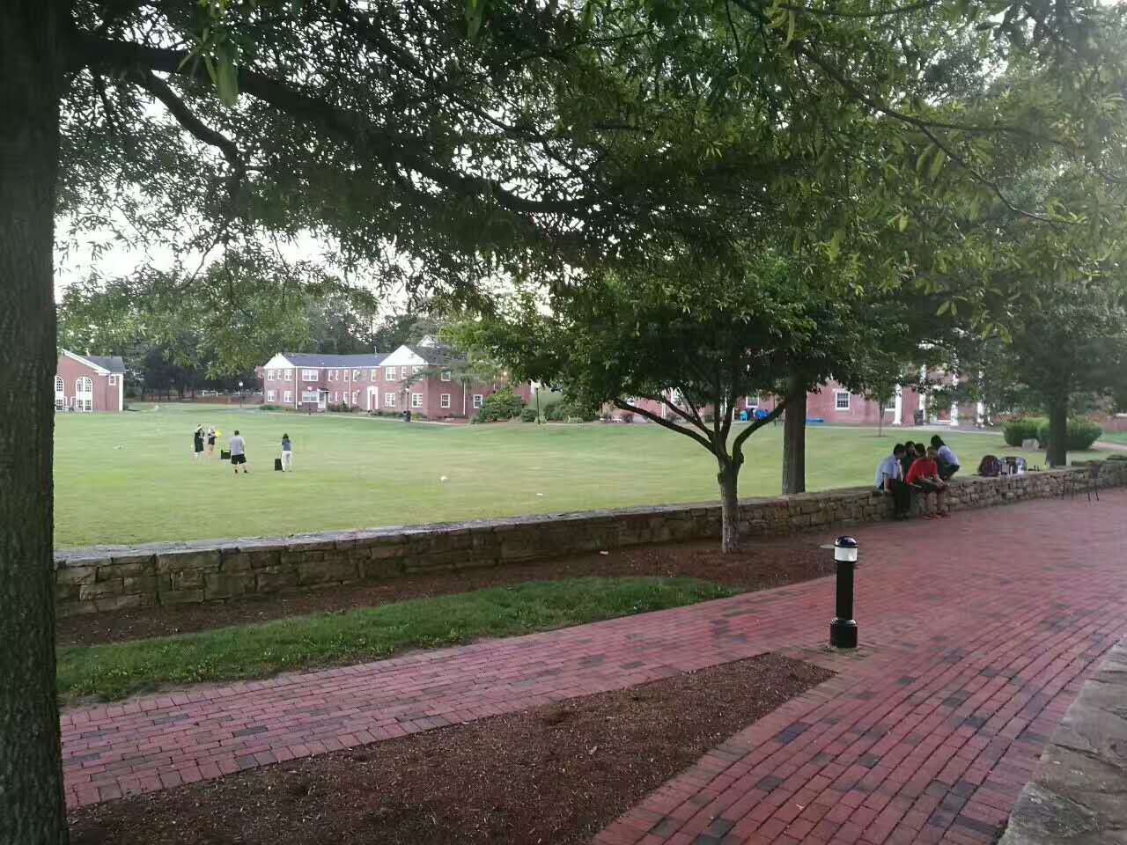
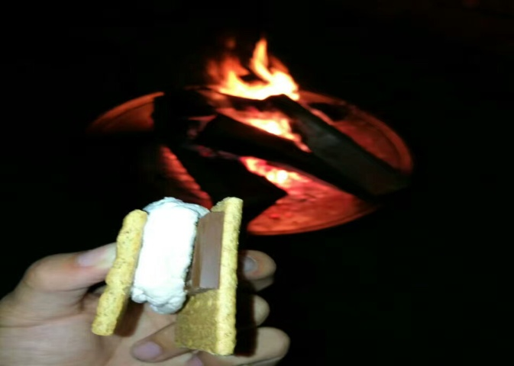

This summer provided me with a chance to make more friends and expand my horizons

Slide 7

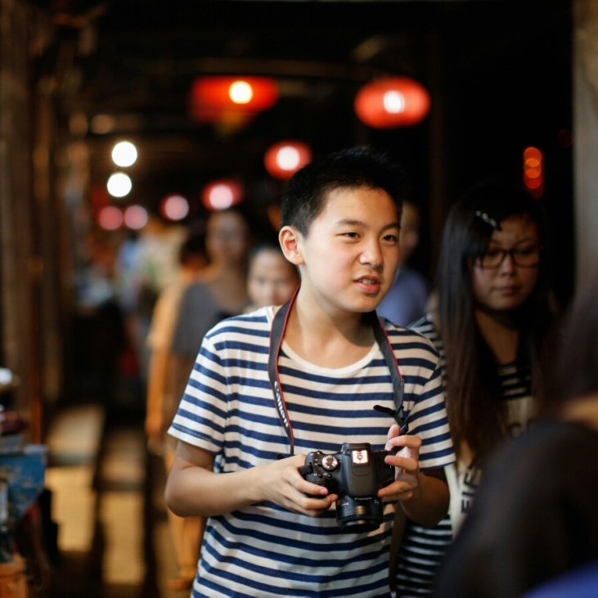
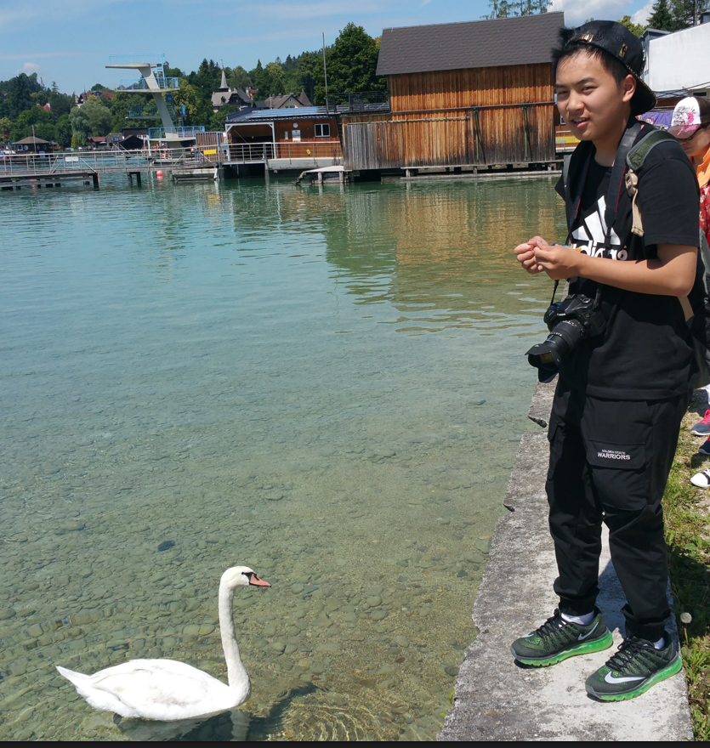
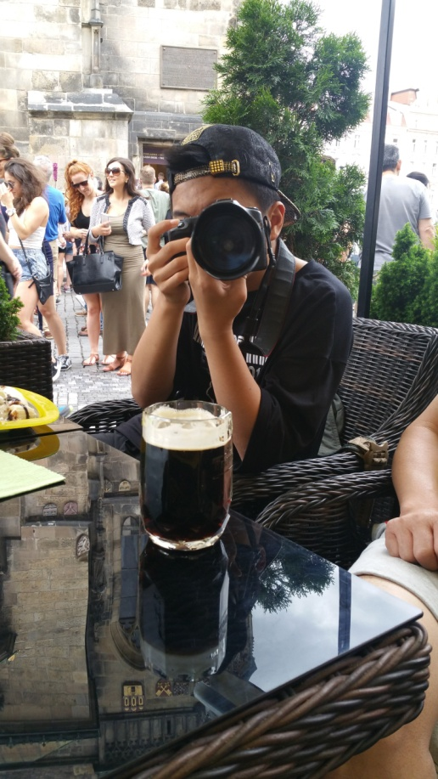
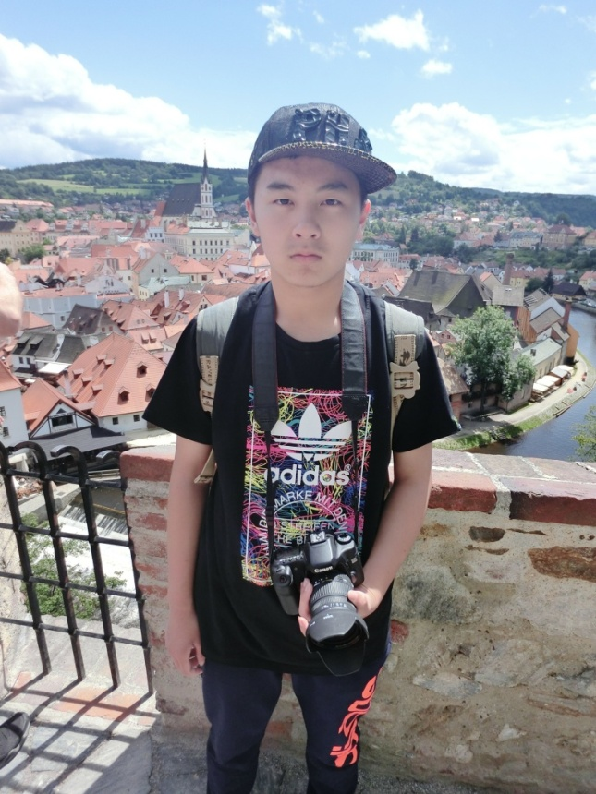
Enjoying the views and classic architecture of Europe

Slide 8

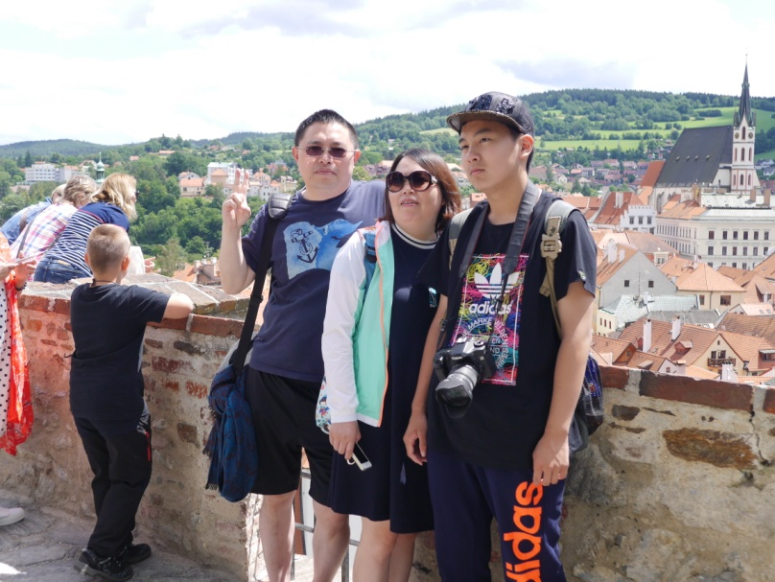
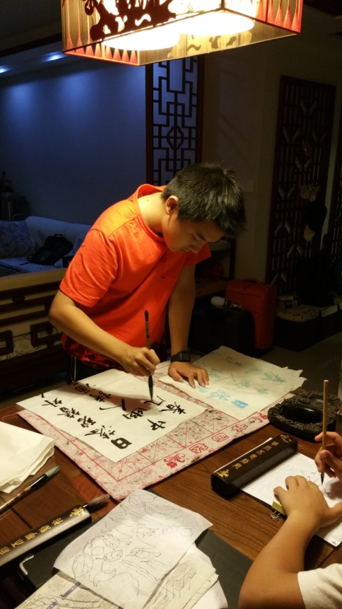
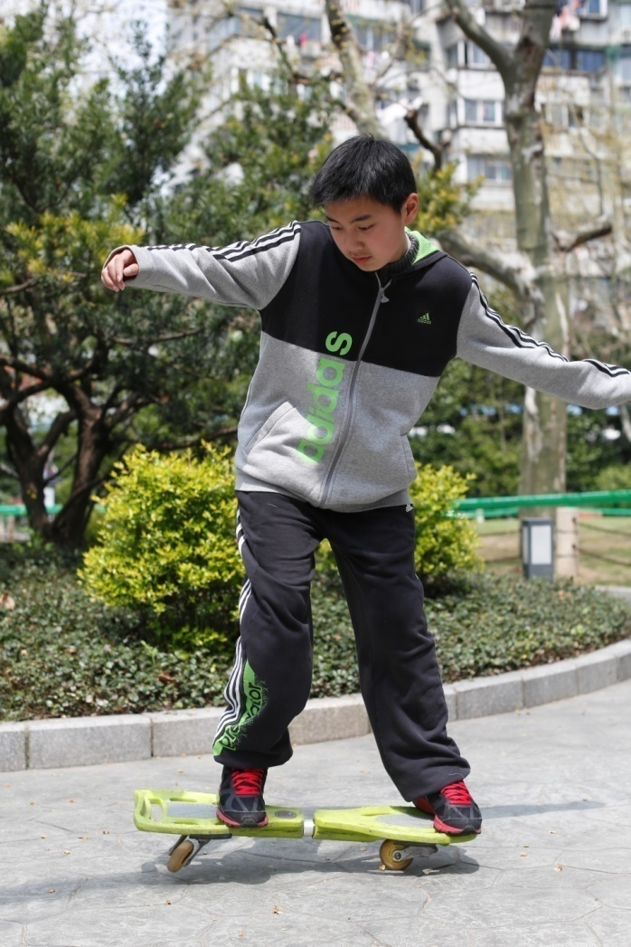
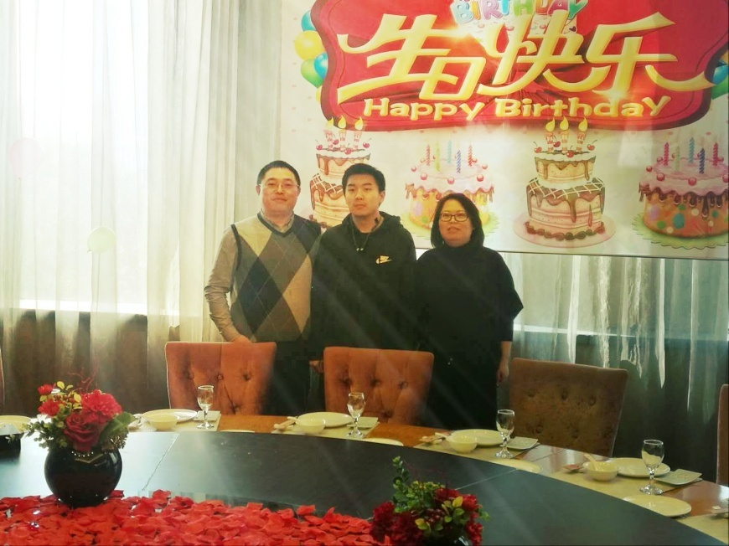
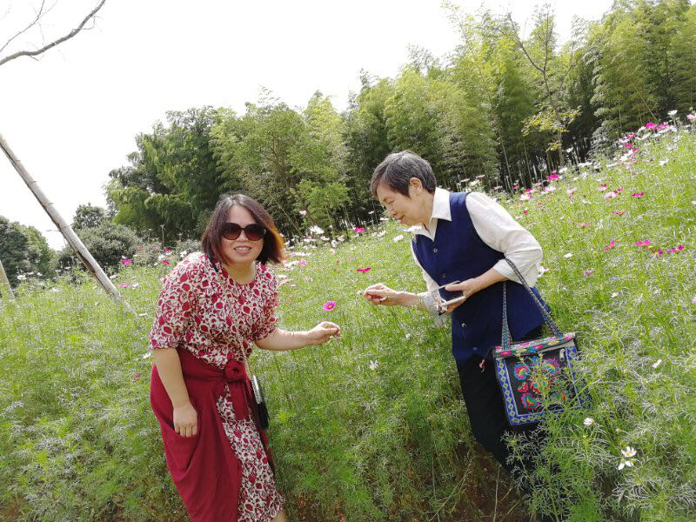

My daily life and my family

Slide 9
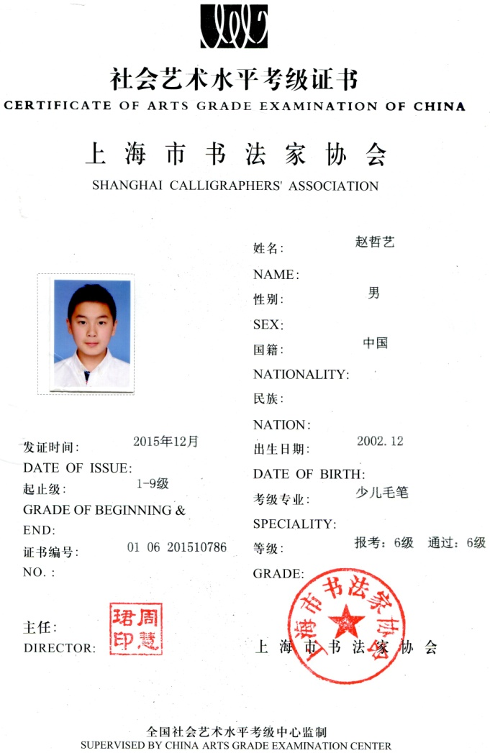
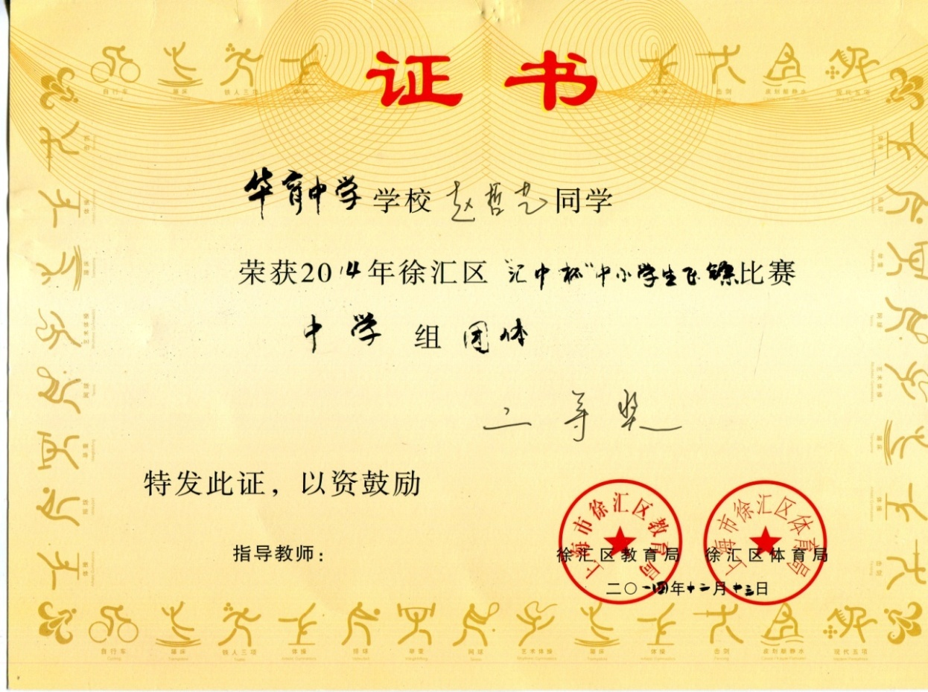
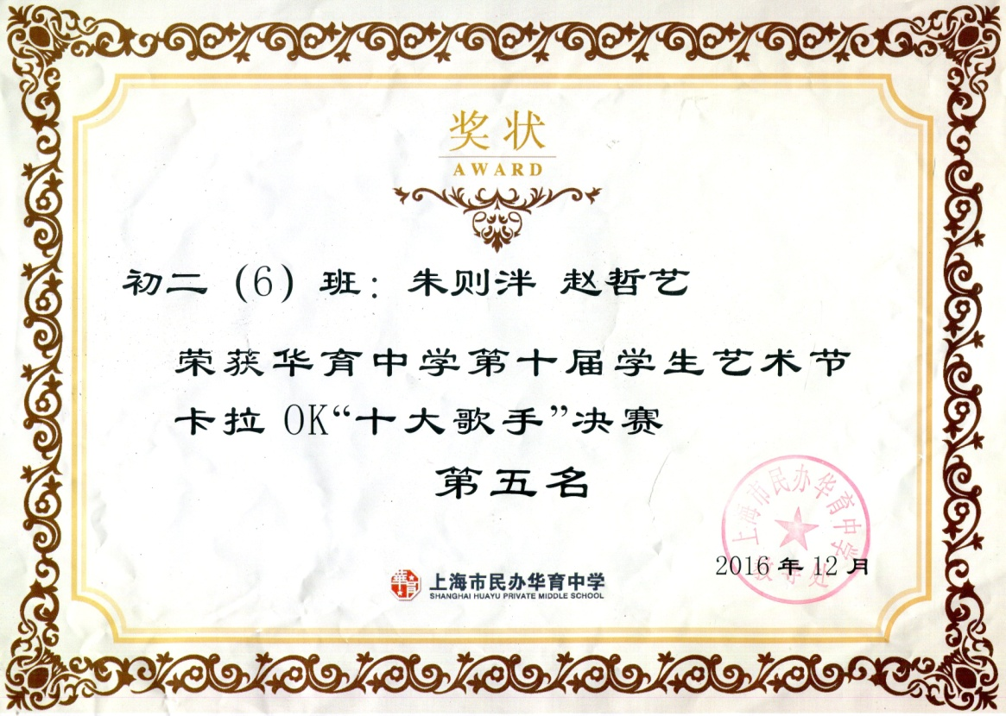
My Awards

